Slide 1
CAR ACCIDENT SEVERITY PREDICTION
-by Aurindom Mahanti

Slide 2
Introduction
There are various means to travel on road be it vehicle, cycle or even pedestrians walking by it.
And for all this to be good utmost safety must be there for people traversing. So we need to decrease the probability of accident related to it.
With the given data we’re trying to predict the severity of injury so that betterment of physical conditions around the road can be done and proper immediate medical and other required support be provided quickly.

Slide 3
Data acquisition and cleaning
Dataset can be accessed through the link (https://s3.us.cloud-object-storage.appdomain.cloud/cf-courses-data/CognitiveClass/DP0701EN/version-2/Data-Collisions.csv).
Dataset has 37 columns which needs to be filtered to get the relevant features only. So that our analysis can produce better results.
Rows with value “unmatched” in the status column has to be removed from the dataset.
And there are a lot of rows with missing values which has to be handled properly as per the columns.

Slide 4
Features and Target for our analysis:
FEATURES:
LIGHTCOND
VEHCOUNT
WEATHER
ROADCOND
COLLISIONTYPE
UNDERINFL
INATTENTIONIND
SPEEDING
TARGET:
SEVERITYCODE(1 or 2)

Slide 5
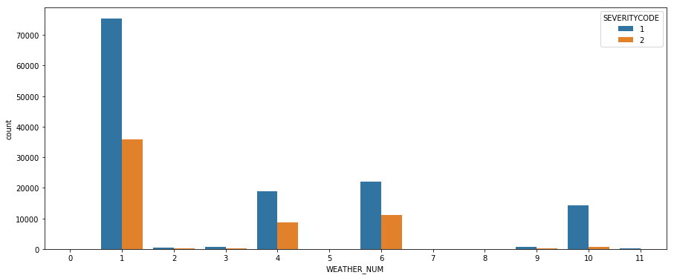
Effect of Weather on Severity
There are 12 types of weather in the dataset.

Slide 6
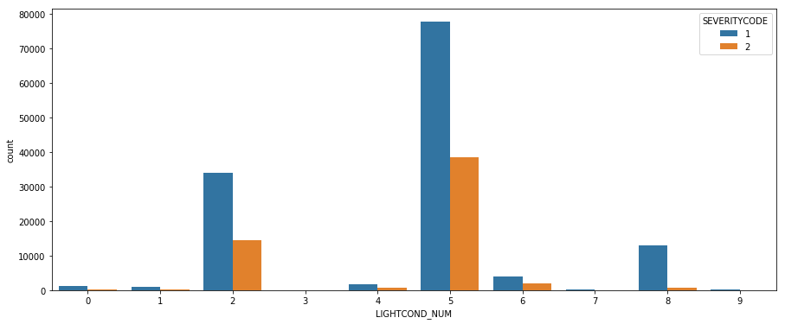
Effect of Light condition on Severity
There are 10 types of light conditions in the dataset.

Slide 7
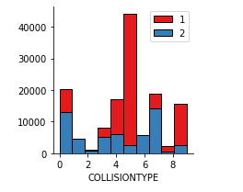
Collision involving pedestrian and cyclist are the worst
In this case different types of collision types are converted to whole number to make it useful for machine learning algorithm.

Slide 8
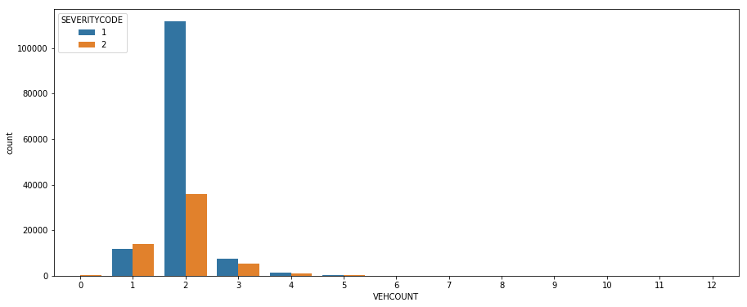
Effect of Vehicle count on Severity
There are 13 types of vehicle count in the dataset.

Slide 9
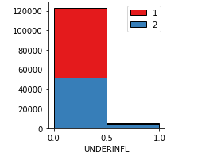
Best to have no influence of drugs or alcohol while driving
It’s quite good to follow some driving rules when you have driving wheel in your hand. It has been found in our dataset that being under influence of drugs or alcohol increases the chances of injury.

Slide 10
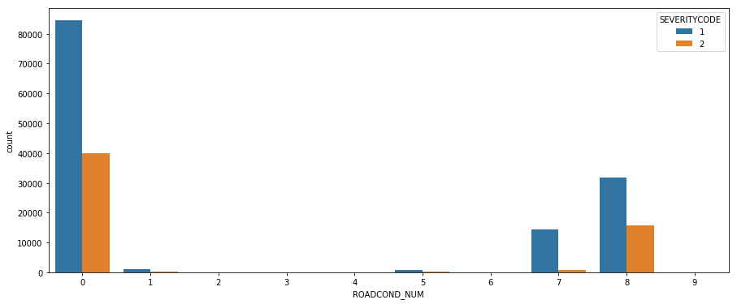
Effect of Road Condition on Severity
There are 10 types of road condition in the dataset.

Slide 11
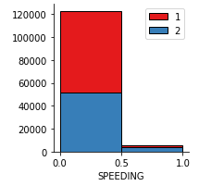
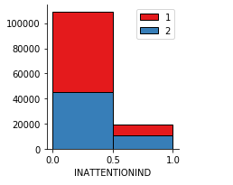
Show attention with speed limit while on the road
Always drive under the speed limit with
proper attention on road. Its good for
you and others travelling on the road.
As both speeding and inattention have
been proven to have severe affects on
the safety.

Slide 12
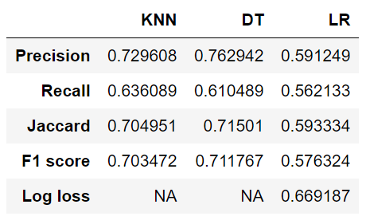
Predictive modelling
Table1: Test data accuracy report
Three machine learning algorithms were used for the classification purpose. Decision seemed to be the ideal technique for prediction

Slide 13
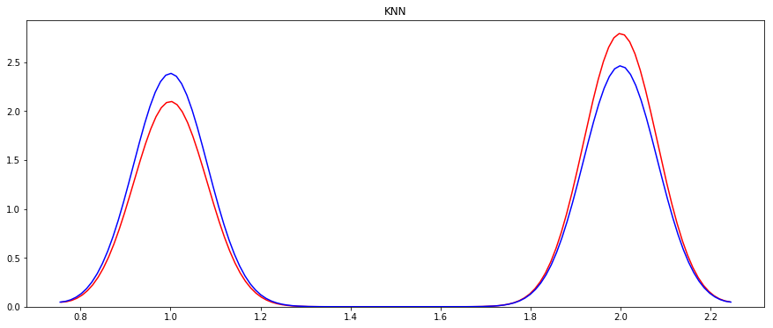
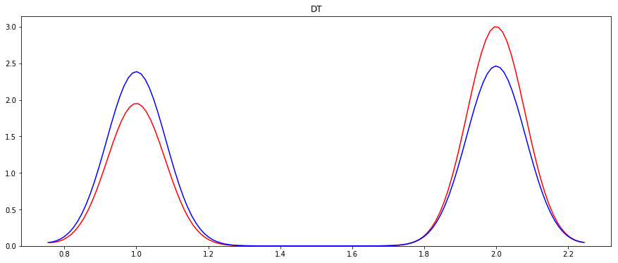
Conclusion
Distribution graph of actual and predicted
values in KNN
Distribution graph of actual and predicted
values in Decision Tree

Slide 14
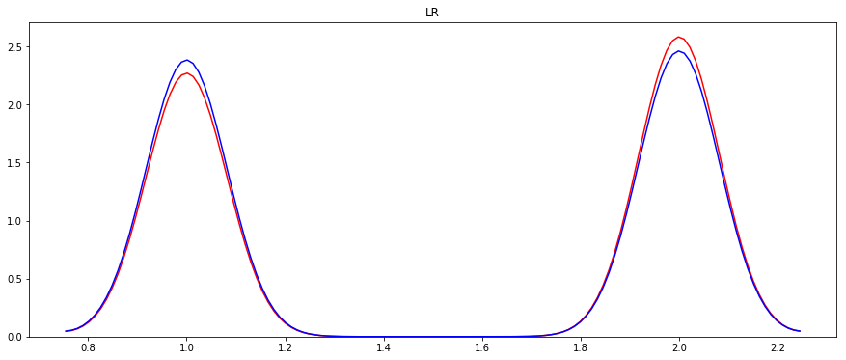
Conclusion (Contd…)
Distribution graph of actual and predicted values in Logistic Regression

Slide 15
Conclusion (Contd…)
Looking at the above distribution plots we can infer that Logistic Regression even though has lower accuracy and precision, fits the curve better than the rest of them. This is most likely because the target value is binary and evaluation parameter log loss is useful.
Hence for this model we consider Logistic Regression to be the best optimum technique rather than Decision Tree.

